Slide 1
English Estates/English Woods Homeowners Association General Meeting
March 18, 2023
2:30 – 4:30 PM

Slide 2
Agenda
Oxford Road Sidewalk and Drainage Improvement Project
HOA Business
Casselberry Utilities Water Main Replacement Project
NOTE: This meeting is informational to EE-EW homeowners. A public meeting will be held prior to commencement of each project for public input. Your questions & concerns are welcome.

Slide 3
Oxford Road Sidewalk and Drainage Improvement Project
Justification
Infrastructure along Oxford Road such as storm drains, sidewalks, and swale grading have deteriorated over time and are in need of repair
Provides sidewalk access to homeowners west of Oxford road to walk to/from school and only cross Oxford at existing crossing guard
ADA compatibility
Will affect right-of-way on both sides of Oxford road, and north side of Derbyshire
Will replace sidewalk on east side of Oxford from East Blvd. to Derbyshire
Will add new sidewalk on west side of Oxford from East Blvd. to Derbyshire
Will replace sections of sidewalk on Derbyshire from Winston to Glastonberry
No trees plan to be removed for this project

Slide 4
HOA Business
New Officers elected for 2023
John Murphy (President)
Mark Hardin (Vice President)
Melissa Hazard (Treasurer)
Caroline Wilkerson (Secretary)
Treasurer Report
Property Items
Right-of-Way Identification
Maintenance

Slide 5
HOA Business Treasurer Report
541 total properties, 66 rental properties
2022 – total of 246 paid members (45%)
2023 – total of 168 paid members (31%) as of March 1 2023
Unaudited account balance of $8167.78 as of March 13, 2023

Slide 6
HOA Business Property Items
Right-of-Way Identification
12.5 feet from edge of curb in front yard is required for utility right-of-way
Trees, landscaping, driveways, irrigation lines, etc. in right-of-way may be impacted by utility work
Maintenance
The Seminole County Code (SCC) defines how private residential properties are to be maintained
https://library.municode.com/fl/seminole_county/codes/code_of_ordinances
Your HOA attempts to work with homeowners to address issues of public safety and health before these become necessary to refer to Code Enforcement

Slide 7
Casselberry Utilities Water Main Replacement Project
Justification
Our 63 year old water mains are near end of life (50-70 years)
<See Water Main Break Rates Study in US and Canada>
Replacement required to prevent rupture and loss of water supply
Some water mains are undersized for current usage (2” diameter)
Will affect all properties within EE-EW in Phases
Will be coordinated with County’s Oxford Road Project
Most of the water mains are asbestos-cement requiring abatement of asbestos
New water mains will be PVC

Slide 8
Casselberry Utilities Water Main Replacement Project
Replacement method
Open trenching (Currently only method permitted by County)
MAJOR impact to driveways, landscaping, and trees
Completely removes existing water main
Requires approx. 3’ by 5’ trench to be dug through properties with existing water main
Pipe Bursting and Horizontal Boring/Grout Fill (Currently not permitted by County)
Minor impact to driveways, landscaping, and trees
Leaves existing water main in place
Small pits are required for access to water main
<See Trenchless Water Pipe Technique>

Slide 9
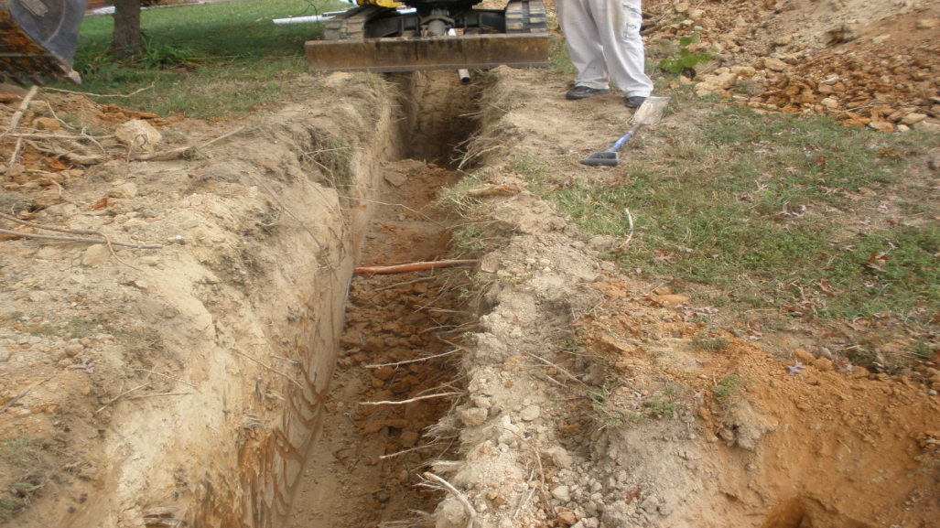
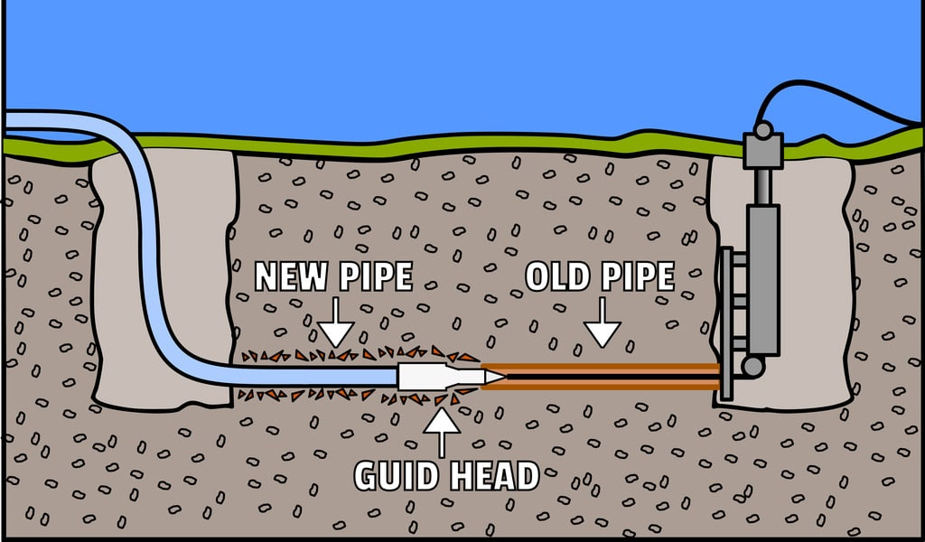
Pipe Bursting
Open
Trenching
Horizontal Boring

